Slide 1
ML Ops – AI Inner Circle
Mark Tabladillo, AI Engineer/Architect
Jason Virtue, Partner CSA

Slide 2
What is DevOps?
Bring together people, processes, and products to automate software delivery & provide continuous value to our users.
Continuous Integration (CI)
Blend together the work of individual engineers in a repository.
Each time you commit code, it’s automatically built and tested, and bugs are detected faster.
Continuous Deployment (CD)
Automate the entire process from code commit to production (if your CI/CD tests are successful.)
Continuous Learning & Monitoring
Safely deliver features to your customers as soon as they’re ready.
Monitor your features in production and know when they aren’t behaving as expected.

Slide 3
What does DevOps for AI mean?

Slide 4
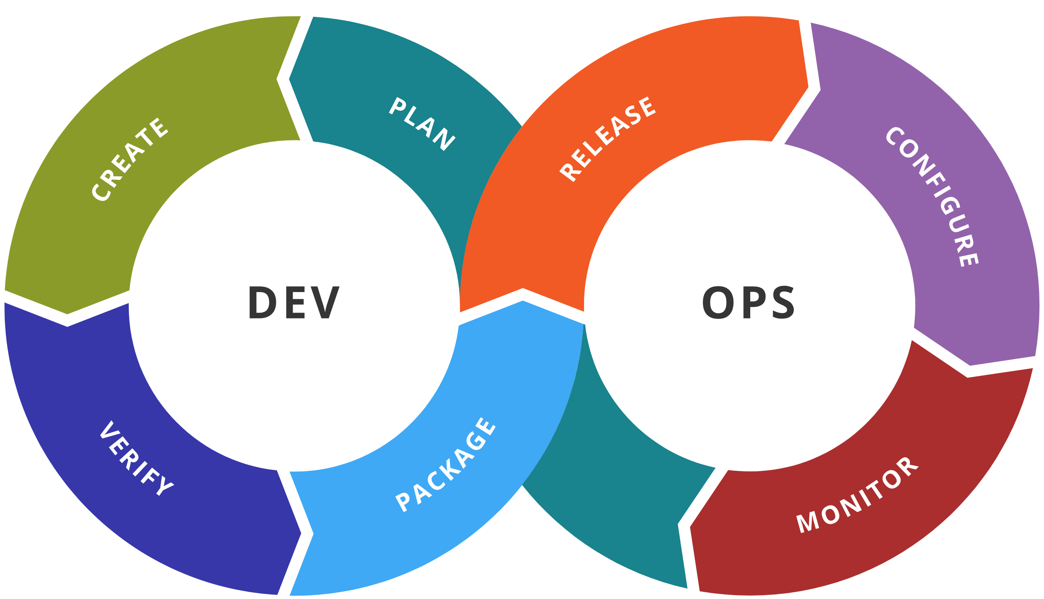
AI DevOps lifecycle
Experiment
Experiment
Data Acquisition
Business Understanding
Initial Modeling
Develop
Modeling
Operate
Continuous Delivery
Data Feedback Loop
System + Model Monitoring
+ Testing
Continuous Integration
Continuous Deployment

Slide 5
MLOps Benefits
Reproducibility / Auditability
Validation
Automation / Observability
Code drives generation and deployments
Pipelines are reproducible and verifiable
All artifacts can be tagged and audited
SWE best practices for quality control
Offline comparisons of model quality
Minimize bias and enable explainability
Controlled rollout capabilities
Live comparison of predicted vs. expected performance
Results fed back to watch for drift and improve model

Slide 6
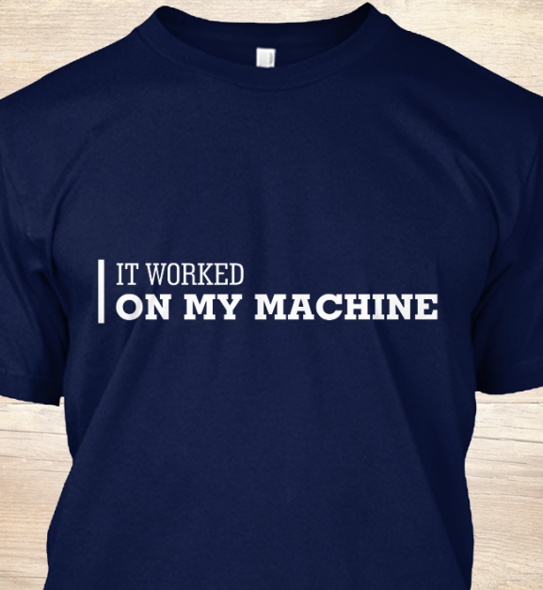
Why adopt DevOps for AI?
Manage pain points:
data scientists and software engineers
Scripts stored on one person's machine and process not repeatable
Model versioning based on names, hard to know where model is deployed
Accuracy of model is determined during training and might change over time because of the data drift
Determine the value of the trained model, decide if it should be deployed

Slide 7
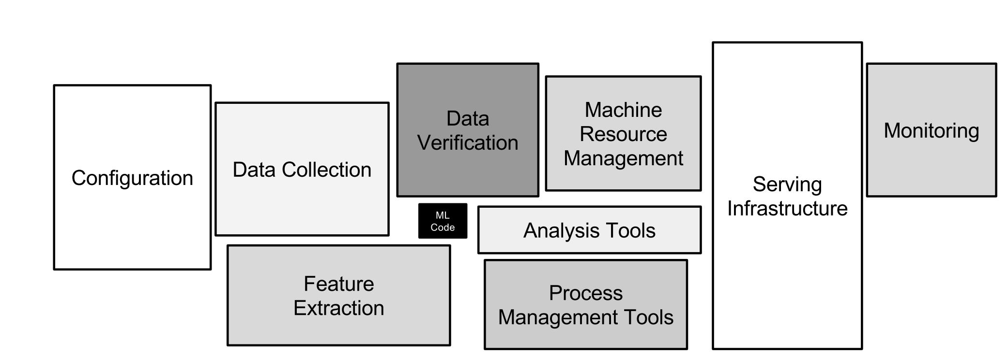
Technical debt & collateral in ML systems
Hidden technical debt in Machine Learning systems

Slide 8
Putting it all together…

Slide 9
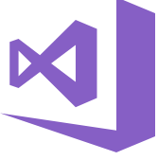
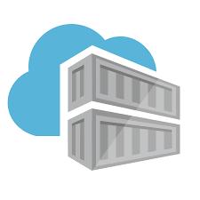

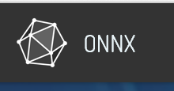
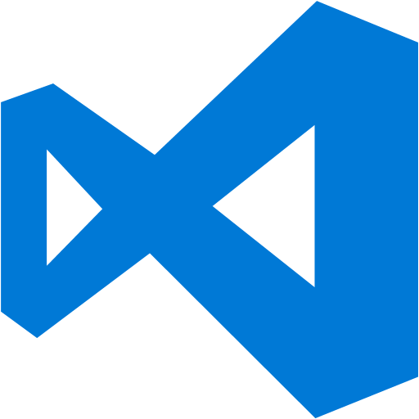




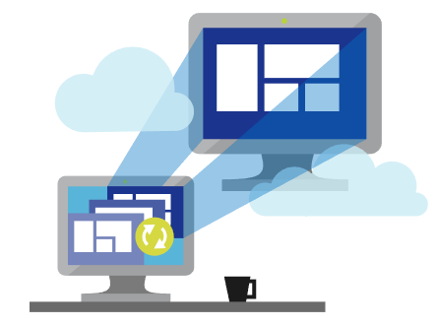
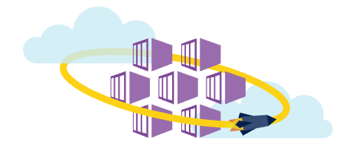
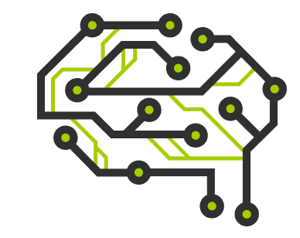
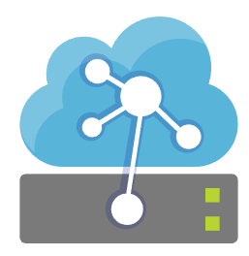
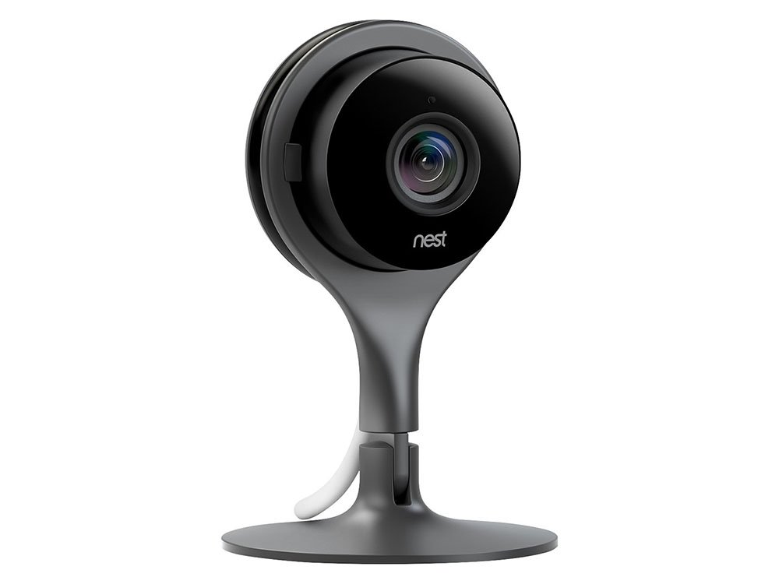
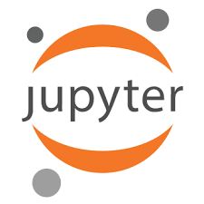

ML + App Dev Process
Update Application
Cntk/Tf/Scikit
Keras/ …
Deploy Application
Cloud Services
App Developer
IDE
DevOps Pipeline
Validate & Flight Model + App
Consume Model
Deploy Model
Apps
Customize Model
Model Store
Predict
Edge Devices
Publish Model
[ { "cat": 0.99218,
"feline": 0.81242 }]
Data Scientist
Retrain Model
Model Telemetry
Collect Feedback
IDE

Slide 10
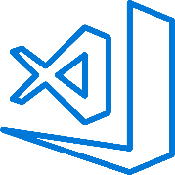
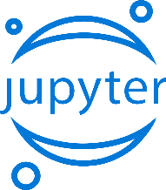

Train & Test Model
Azure MLOps Helps You Bring ML to Production
Register and Manage Model
Integrated with Azure DevOps
Build model (your favorite IDE)
Deploy Service
Monitor Model
Build Image

Slide 11
Azure Machine Learning service
Set of Azure Cloud Services
Python SDK
That enables you to:
Prepare Data
Build Models
Train Models
Manage Models
Track Experiments
Deploy Models

Slide 12
Azure ML service
Key Artifacts
Workspace
Models
Deployments
Experiments
Data Stores
ML Pipelines
Compute Targets

Slide 13

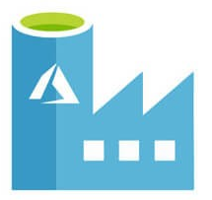

MLOps Process
Enterprise ready machine learning development
Data Engineer
Azure Machine Learning
Data Scientist
Build Model
Azure Data Factory
Data Catalog
Featurize
Train
Evaluate
register
Prepare Data
commit
Model Registry
Code Repo
Data Lake
Release Model
release
DevOps
Package
Validate
Profile
Approve
Deploy
collect
Notes:
[

Slide 14
DEMO

Slide 15
Model Deployment on Azure
Azure Machine Learning + Azure DevOps

Slide 16

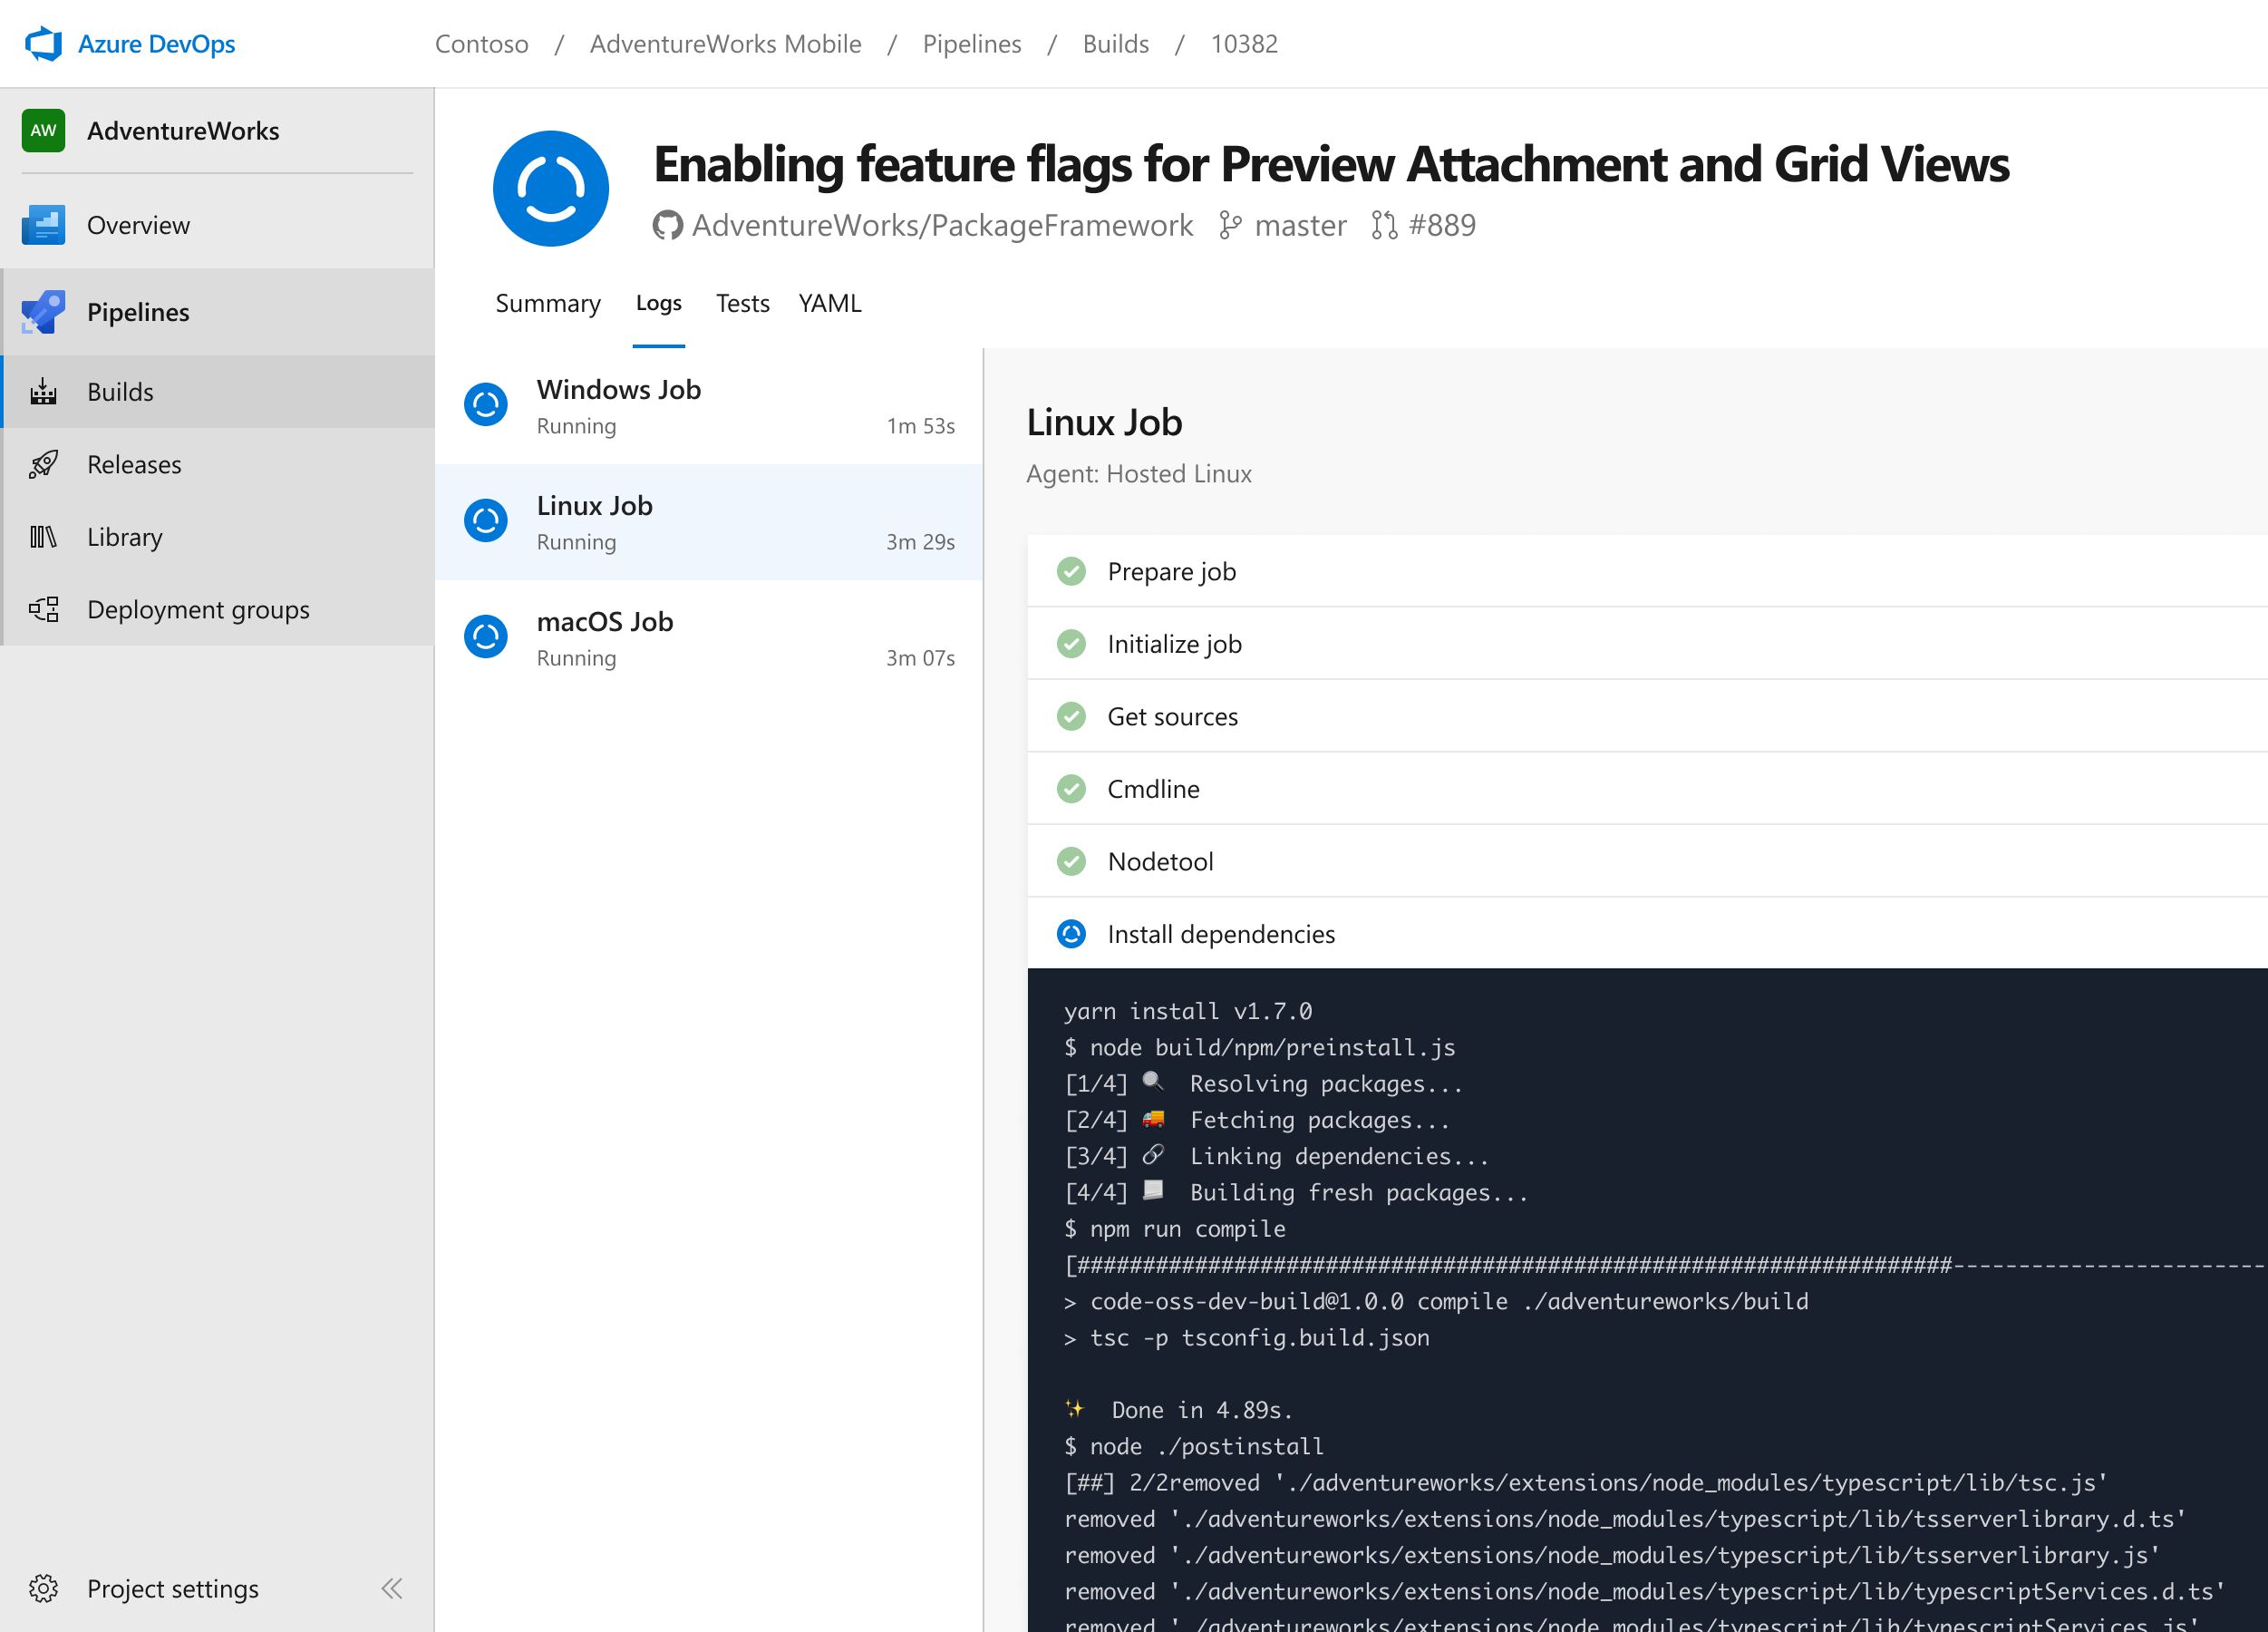


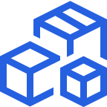
Azure DevOps Pipelines
Cloud-hosted pipelines for Linux, Windows and macOS.
Any language, any platform, any cloud
Build, test, and deploy Node.js, Python, Java, PHP, Ruby, C/C++, .NET, Android, and iOS apps. Run in parallel on Linux, macOS, and Windows. Deploy to Azure, AWS, GCP or on-premises
Extensible
Explore and implement a wide range of community-built build, test, and deployment tasks, along with hundreds of extensions from Slack to SonarCloud. Support for YAML, reporting and more
Containers and Kubernetes
Easily build and push images to container registries like Docker Hub and Azure Container Registry. Deploy containers to individual hosts or Kubernetes.
➔
https://azure.com/pipelines

Slide 17
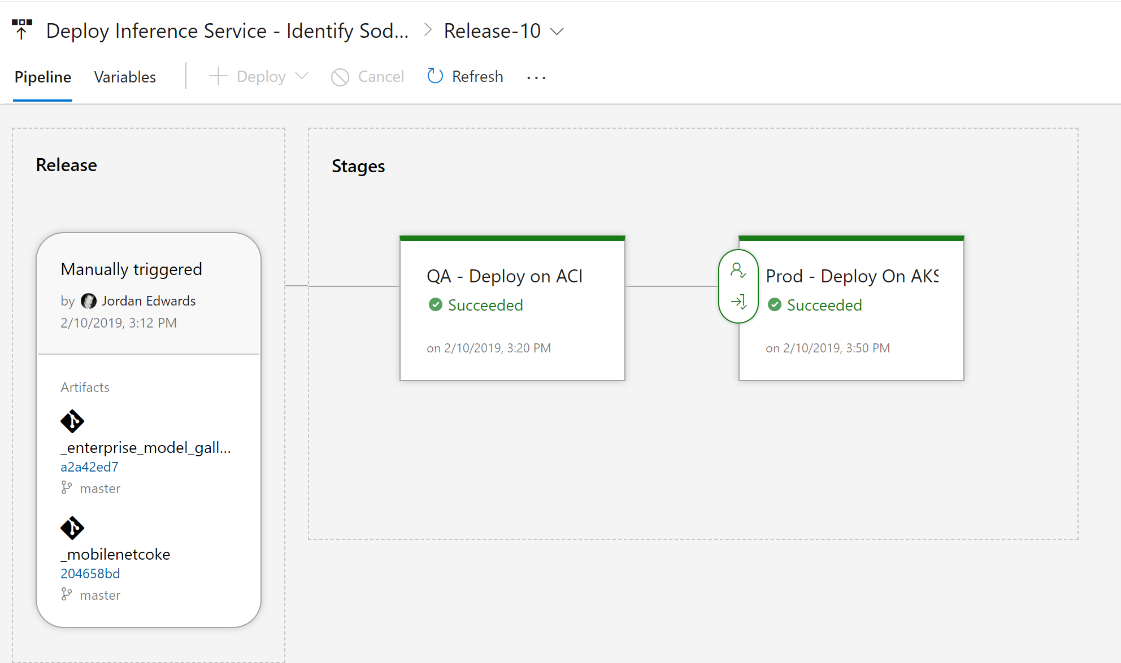
Azure DevOps + Azure ML
Trigger release pipelines on model registration
Use Azure DevOps + Azure ML CLI to manage E2E release flow
Leverage Azure DevOps approvals for controlling application rollout

Slide 18

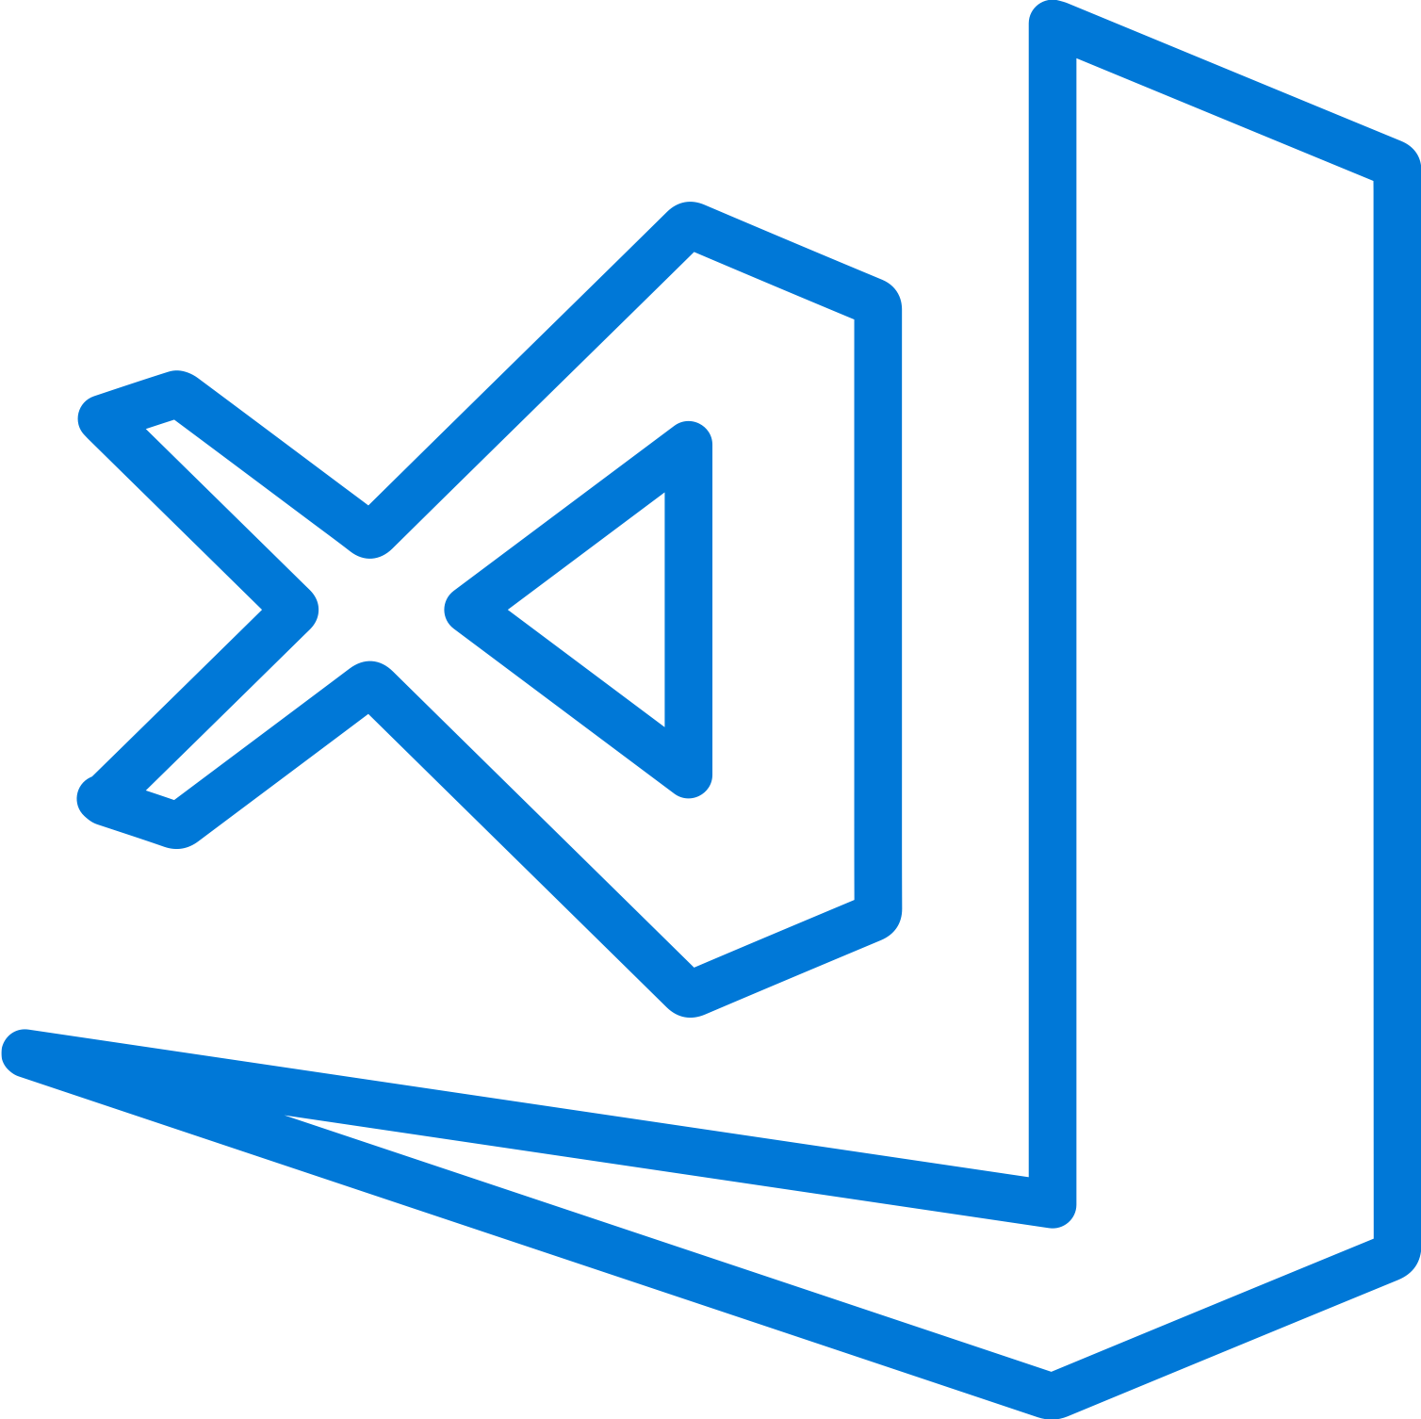
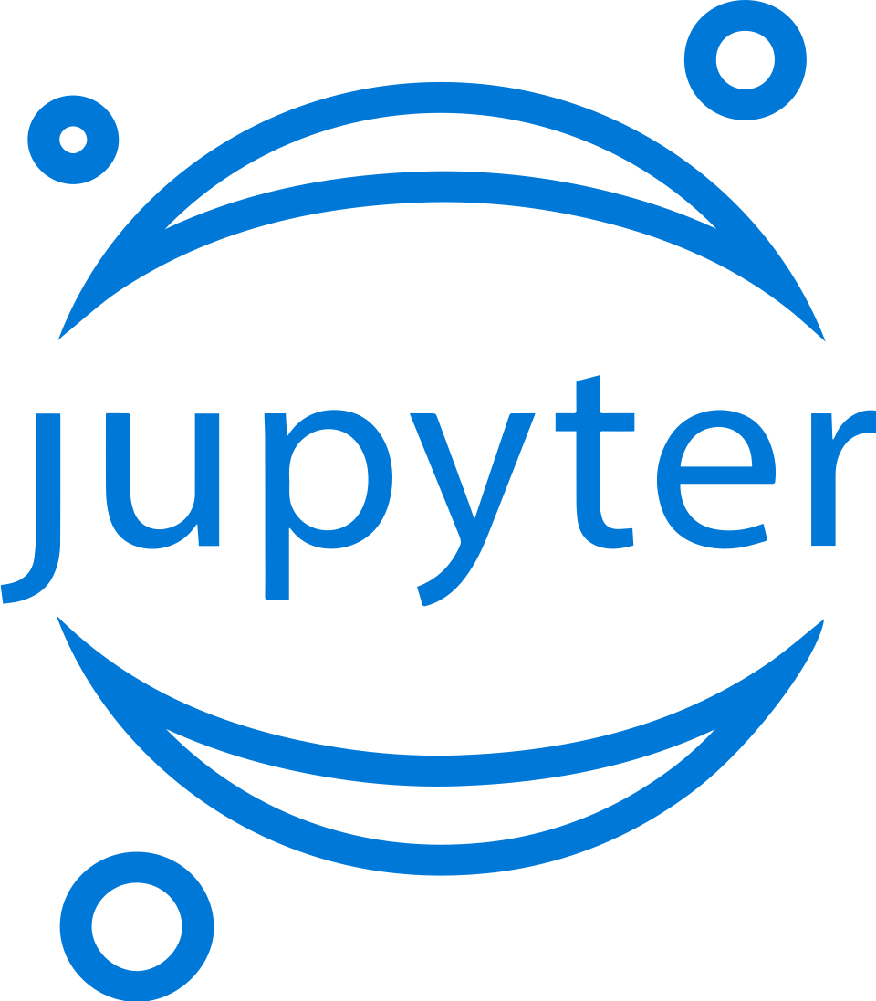

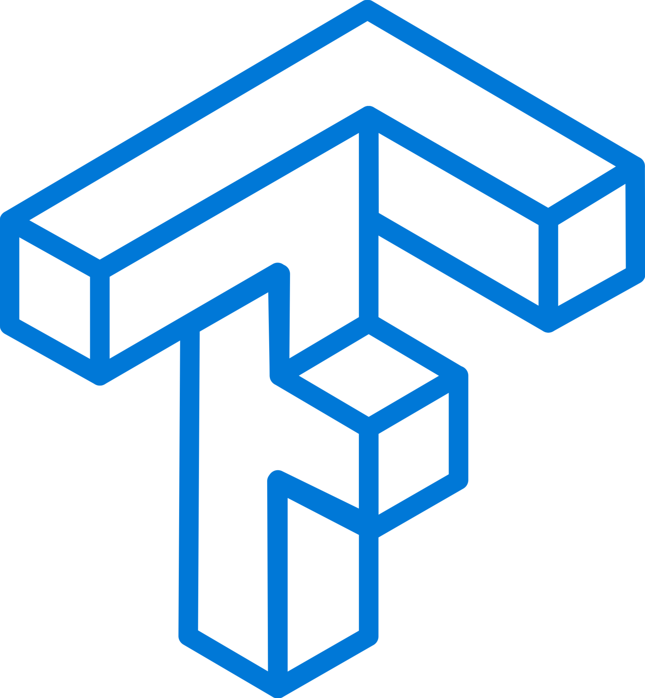
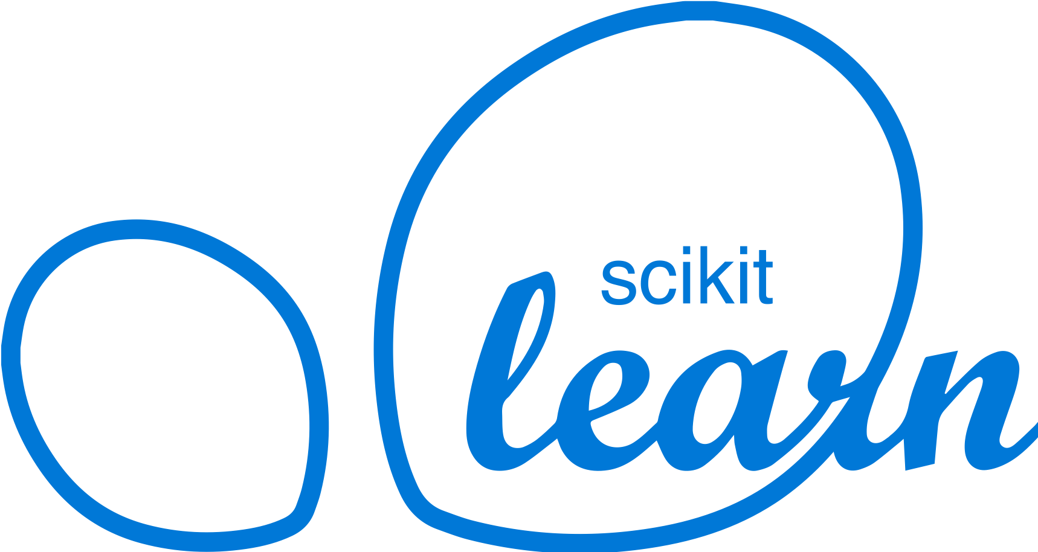
Machine Learning on Azure
Domain specific pretrained models
To simplify solution development
…
Vision
Speech
Language
Search
Familiar Data Science tools
To simplify model development
Visual Studio Code
Azure Notebooks
Jupyter
Command line
Popular frameworks
To build advanced deep learning solutions
PyTorch
TensorFlow
Scikit-Learn
ONNX
Productive services
To empower data science and development teams
Azure Databricks
Azure Machine Learning
Machine Learning VMs
Powerful infrastructure
To accelerate deep learning
CPU
GPU
FPGA
From the Intelligent Cloud to the Intelligent Edge

Slide 19
References
MLOps makes it possible to do production-grade ML
https://aka.ms/mlops
MLOps Reference Architecture
https://github.com/Microsoft/MLOpsPython
AI Reference Architecture
https://github.com/Microsoft/AIReferenceArchitectures
Github Sample
https://github.com/chronicle17/DSDevOps
Notes:
https://github.com/chronicle17/DSDevOps

Slide 20
Feedback
Please take a minute to complete this survey.
https://microsoftanalystrelation.eventbuilder.com/event/9920/survey
This survey will help us deliver the best content for future sessions.
https://www.linkedin.com/in/marktab/
https://www.linkedin.com/in/jasonvirtue

